Slide 1
CIS471/571, Fall 2018
Introduction to Artificial Intelligence
Instructor: Dejing Dou
Office hours: Monday 4:00pm-5:00pm
Oct. 17 and Oct. 19, 2018

Slide 2
Last week
Optimal decisions (minimax algorithms)
α-β pruning
Imperfect, real-time decisions
Constraint Satisfaction Problems (CSP)
Backtracking search for CSPs
Local search for CSPs

Slide 3

Most constrained variable
Most constrained variable:
  choose the variable with the fewest legal values
a.k.a. minimum remaining values (MRV) heuristic

Slide 4

Most constraining variable
Tie-breaker among most constrained variables
Most constraining variable:
  choose the variable with the most constraints on remaining variables

Slide 5

Least constraining value
Given a variable, choose the least constraining value:
  the one that rules out the fewest values in the remaining variables
Combining these heuristics makes 1000 queens feasible

Slide 6

Forward checking
Idea:
  Keep track of remaining legal values for unassigned variables
  Terminate search when any variable has no legal values

Slide 7

Forward checking
Idea:
  Keep track of remaining legal values for unassigned variables
  Terminate search when any variable has no legal values

Slide 8

Forward checking
Idea:
  Keep track of remaining legal values for unassigned variables
  Terminate search when any variable has no legal values

Slide 9

Forward checking
Idea:
  Keep track of remaining legal values for unassigned variables
  Terminate search when any variable has no legal values

Slide 10
Constraint propagation
Forward checking propagates information from assigned to unassigned variables, but doesn't provide early detection for all failures (inconsistencies):
NT and SA cannot both be blue!
Constraint propagation repeatedly enforces constraints locally

Slide 11

Arc consistency
Simplest form of propagation makes each arc consistent
X →Y is consistent iff
  for every value x of X there is some allowed y of Y
  e.g. SA → NSW is consistent

Slide 12

Arc consistency
However, NSW → SA is not consistent because of NSW = blue

Slide 13

Arc consistency
If X loses a value, neighbors of X need to be rechecked, e.g., blue is deleted from NSW, the red has to be deleted from V.

Slide 14

Arc consistency
Arc consistency detects failure earlier than forward checking
Can be run as a preprocessor or after each assignment

Slide 15
Chapter 7: Logical Agents
Knowledge-based agents
Wumpus world
Logic in general – models and entailment
  Soundness and Completeness
Propositional (Boolean) logic
  Equivalence, validity, satisfiability
Inference rules and Reasoning
  forward chaining
  backward chaining
  resolution

Slide 16

Knowledge bases
Knowledge base = set of sentences in a formal language
Declarative approach to building an agent (or other system):
  Tell it what it needs to know, then it can Ask itself what to do - answers should follow from the KB
Agents can be viewed at the knowledge level
  i.e., what they know, regardless of how implemented
Or at the implementation level
  i.e., data structures in KB and algorithms that manipulate them

Slide 17

Wumpus World PEAS description
Performance measure
  gold +1000, death -1000
  -1 per step, -10 for using the arrow
Environment
  Squares adjacent to wumpus are smelly
  Squares adjacent to pit are breezy
  Glitter iff gold is in the same square
  Shooting kills wumpus if you are facing it
  Shooting uses up the only arrow
  Grabbing picks up gold if in same square
  Releasing drops the gold in same square
Sensors: Stench, Breeze, Glitter, Bump, Scream
Actuators: Left turn, Right turn, Forward, Grab, Release, Shoot
Notes:
adjacent: &-'jA-s&nt

Slide 18

Exploring a wumpus world

Slide 19

Exploring a wumpus world

Slide 20

Exploring a wumpus world

Slide 21

Exploring a wumpus world

Slide 22

Exploring a wumpus world

Slide 23

Exploring a wumpus world

Slide 24

Exploring a wumpus world

Slide 25

Exploring a wumpus world

Slide 26
Logic in general
Logics are formal languages for representing information such that conclusions can be drawn
Syntax defines whether the sentences are well formed
Semantics define the "meaning" of sentences;
  i.e., define truth of a sentence in a world
E.g., the language of arithmetic
  x+2 ≥ y is a sentence; x2+y > {} is not a sentence
  x+2 ≥ y is true iff the number x+2 is no less than the number y
  x+2 ≥ y is true in a world (model) where x = 7, y = 1
  x+2 ≥ y is false in a world (model) where x = 0, y = 6

Slide 27
Entailment
Entailment means that one thing follows from another:
KB ╞ α
Knowledge base KB entails sentence α if and only if α is true in all worlds (models) where KB is true
  E.g., x+y = 4 entails 4 = x+y
  Entailment is a relationship between sentences (i.e., syntax) that is based on semantics

Slide 28

Models
Logicians typically think in terms of models, which are formally structured worlds with respect to which truth can be evaluated
We say m is a model of a sentence α if α is true in m
M(α) is the set of all models of α
Then KB ╞ α iff M(KB) ⊆ M(α)
or M(α) ⊆ M(KB) ?

Slide 29

Entailment in the wumpus world
Situation after detecting nothing in [1,1], moving right, breeze in [2,1]
Consider possible models for KB assuming only pits
3 Boolean choices ⇒ 8 possible models

Slide 30

Wumpus models

Slide 31

Wumpus models
KB = wumpus-world rules + observations

Slide 32

Wumpus models
KB = wumpus-world rules + observations
α₁ = "[1,2] is safe", KB ╞ α₁, proved by model checking

Slide 33
Wumpus models
KB = wumpus-world rules + observations

Slide 34

Wumpus models
KB = wumpus-world rules + observations
α₂ = "[2,2] is safe", KB ╞ α₂

Slide 35
Inference
KB ├_{i} α = sentence α can be derived from KB by procedure i
Soundness: i is sound if whenever KB ├_{i} α, it is also true that KB╞ α
Completeness: i is complete if whenever KB╞ α, it is also true that KB ├_{i} α
A sound and complete inference procedure will answer any question whose answer follows from what is known by the KB.

Slide 36
Propositional logic: Syntax
Propositional logic is the simplest logic – illustrates basic ideas
The proposition symbols P₁, P₂ etc are sentences
  If S is a sentence, ¬S is a sentence (negation)
  If S₁ and S₂ are sentences, S₁ ∧ S₂ is a sentence (conjunction)
  If S₁ and S₂ are sentences, S₁ ∨ S₂ is a sentence (disjunction)
  If S₁ and S₂ are sentences, S₁ ⇒ S₂ is a sentence (implication)
  If S₁ and S₂ are sentences, S₁ ⇔ S₂ is a sentence (biconditional)

Slide 37
Propositional logic: Semantics
Each model specifies true/false for each proposition symbol
  E.g. P_{1,2} P_{2,2} P_{3,1}
  false true false
  Rules for evaluating truth with respect to a model m:
¬S is true iff S is false
S₁ ∧ S₂ is true iff S₁ is true and S₂ is true
S₁ ∨ S₂ is true iff S₁is true or S₂ is true
S₁ ⇒ S₂ (¬ S₁ ∨ S₂) is true iff S₁ is false or S₂ is true
is false iff S₁ is true and S₂ is false
S₁ ⇔ S₂ is true iff S₁⇒S₂ is true andS₂⇒S₁ is true
Simple recursive process evaluates an arbitrary sentence, e.g.,
¬P_{1,2} ∧ (P_{2,2} ∨ P_{3,1}) = true ∧ (true ∨ false) = true ∧ true = true

Slide 38

Truth tables for connectives
P ⇒ Q is equivalent to (¬ P ∨ Q)

Slide 39
Wumpus world sentences
Let P_{i,j} be true if there is a pit in [i, j].
Let B_{i,j} be true if there is a breeze in [i, j].
  ¬ P_{1,1}
  ¬B_{1,1}
  B_{2,1}
"Pits cause breezes in adjacent squares"
  B_{1,1} ⇔ (P_{1,2} ∨ P_{2,1})
  B_{2,1} ⇔ (P_{1,1} ∨ P_{2,2} ∨ P_{3,1})

Slide 40

Truth tables for inference

Slide 41

Inference by enumeration
Depth-first enumeration of all models is sound and complete
For n symbols, time complexity is O(2^{n}), space complexity is O(n)

Slide 42

Logical equivalence
Two sentences are logically equivalent iff true in same models: α ≡ ß iff α╞ β and β╞ α

Slide 43
Validity and satisfiability
A sentence is valid if it is true in all models,
  e.g., True, A ∨¬A, A ⇒ A, (A ∧ (A ⇒ B)) ⇒ B
Validity is connected to inference via the Deduction Theorem:
  KB ╞ α if and only if (KB ⇒ α) is valid
A sentence is satisfiable if it is true in some model
  e.g., A∨ B, C
A sentence is unsatisfiable if it is true in no model
  e.g., A∧¬A
Satisfiability is connected to inference via the following:
  KB ╞ α if and only if (KB ∧¬α) is unsatisfiable

Slide 44
Resolution
Conjunctive Normal Form (CNF)
  conjunction of disjunctions of literal clauses
  E.g., (A ∨ ¬B) ∧ (B ∨ ¬C ∨ ¬D)
Resolution inference rule (for CNF):
l_{i} ∨… ∨ l_{k}, m₁ ∨ … ∨ m_{n}
l_{i} ∨ … ∨ l_{i-1} ∨ l_{i+1} ∨ … ∨ l_{k} ∨ m₁ ∨ … ∨ m_{j-1} ∨ m_{j+1} ∨... ∨ m_{n}
where l_{i} and m_{j} are complementary literals (l_{i} ⬄ ¬m_{j})
E.g., P_{1,3} ∨ P_{2,2}, ¬P_{2,2}
P_{1,3}
Resolution is sound and complete
for propositional logic

Slide 45
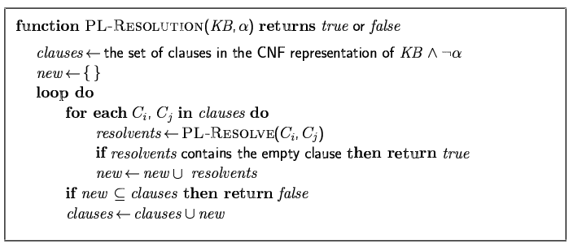
Resolution algorithm
Proof by contradiction, i.e., show KB∧¬α unsatisfiable

Slide 46

Resolution example
KB = (B_{1,1} ⇔ (P_{1,2}∨ P_{2,1})) ∧¬ B_{1,1} α = ¬P_{1,2}

Slide 47
Forward and backward chaining
Horn Form (restricted)
  KB = conjunction of Horn clauses
  Horn clause =
    proposition symbol; or
    (conjunction of symbols) ⇒ symbol
  E.g., C ∧ (B ⇒ A) ∧ (C ∧ D ⇒ B)
Modus Ponens (for Horn Form): complete for Horn KBs
α₁, … ,α_{n}, α₁ ∧ … ∧ α_{n} ⇒ β
β
Can be used with forward chaining or backward chaining.
These algorithms are very natural and run in linear time

Slide 48
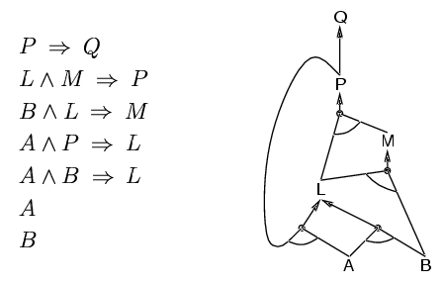
Forward chaining
Idea: fire any rule whose premises are satisfied in the KB,
  add its conclusion to the KB, until query is found

Slide 49
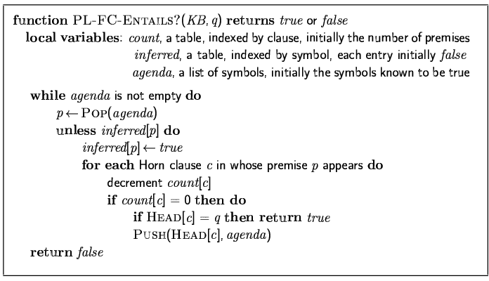
Forward chaining algorithm
Forward chaining is sound and complete for Horn KB

Slide 50
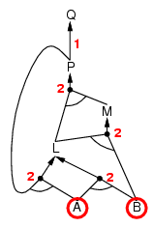
Forward chaining example

Slide 51
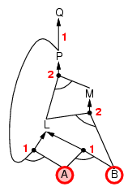
Forward chaining example

Slide 52
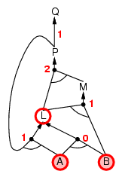
Forward chaining example

Slide 53
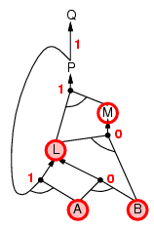
Forward chaining example

Slide 54
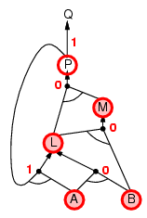
Forward chaining example

Slide 55
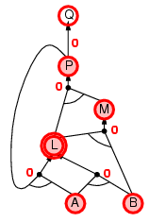
Forward chaining example

Slide 56
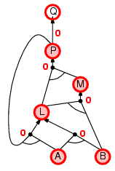
Forward chaining example

Slide 57

Forward chaining example

Slide 58
Proof of completeness
FC derives every atomic sentence that is entailed by KB
  FC reaches a fixed point where no new atomic sentences are derived
  Consider the final state as a model m, assigning true/false to symbols
  Every clause in the original KB is true in m
    a₁ ∧ … ∧ a_{k} ⇒ b
  Hence m is a model of KB
  If KB╞ q, q is true in every model of KB, including m

Slide 59
Backward chaining
Idea: work backwards from the query q:
  to prove q by BC,
    check if q is known already, or
    prove by BC all premises of some rule concluding q
Avoid loops: check if new subgoal is already on the goal stack
Avoid repeated work: check if new subgoal
  has already been proved true, or
  has already failed

Slide 60
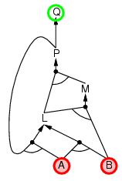
Backward chaining example

Slide 61
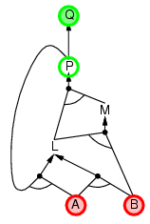
Backward chaining example

Slide 62
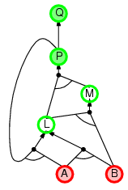
Backward chaining example

Slide 63
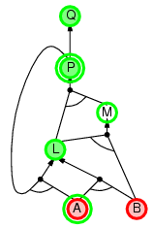
Backward chaining example

Slide 64
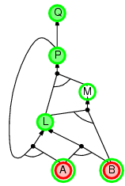
Backward chaining example

Slide 65
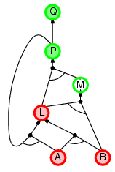
Backward chaining example

Slide 66
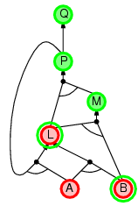
Backward chaining example

Slide 67
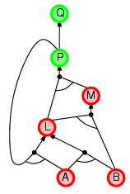
Backward chaining example

Slide 68
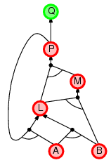
Backward chaining example

Slide 69
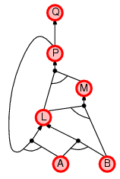
Backward chaining example

Slide 70
Forward vs. backward chaining
FC is data-driven, automatic, unconscious processing,
  e.g., object recognition, routine decisions
May do lots of work that is irrelevant to the goal
BC is goal-driven, appropriate for problem-solving,
  e.g., Where are my keys? How do I get a A in CIS571?
Complexity of BC can be much less than linear in size of KB

Slide 71
Efficient propositional inference
Two families of efficient algorithms for propositional inference:
Complete backtracking search algorithms
  DPLL algorithm (Davis, Putnam, Logemann, Loveland)
Incomplete local search algorithms
  WalkSAT algorithm

Slide 72
Hard satisfiability problems
Consider random 3-CNF sentences. e.g.,
(¬D ∨ ¬B ∨ C) ∧ (B ∨ ¬A ∨ ¬C) ∧ (¬C ∨ ¬B ∨ E) ∧ (E ∨ ¬D ∨ B) ∧ (B ∨ E ∨ ¬C)
  m = number of clauses
  n = number of symbols

Slide 73
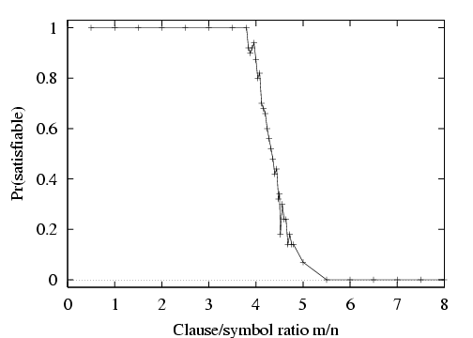
Hard satisfiability problems

Slide 74
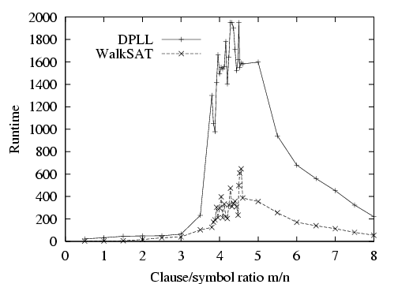
Hard satisfiability problems
Median runtime for 100 satisfiable random 3-CNF sentences, n = 50

Slide 75
Inference-based agents in the wumpus world
A wumpus-world agent using propositional logic:
  ¬P_{1,1}
  ¬W_{1,1}
  B_{x,y} ⇔ (P_{x,y+1} ∨ P_{x,y-1} ∨ P_{x+1,y} ∨ P_{x-1,y})
  S_{x,y} ⇔ (W_{x,y+1} ∨ W_{x,y-1} ∨ W_{x+1,y} ∨ W_{x-1,y})
  W_{1,1} ∨ W_{1,2} ∨ … ∨ W_{4,4}
  ¬W_{1,1} ∨ ¬W_{1,2}
  ¬W_{1,1} ∨ ¬W_{1,3}
  …
⇒ 64 distinct proposition symbols, 155 sentences

Slide 76
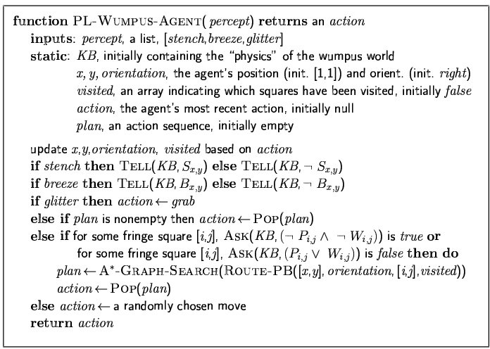

Slide 77
Chapter 8: FOL
Why first order logic?
Syntax and semantics of FOL
Using FOL
Wumpus world in FOL
Knowledge engineering in FOL

Slide 78
Adv. and Limit of Propositional logic
Propositional logic is declarative
Propositional logic allows partial/disjunctive/negated information
  (unlike most data structures and databases)
Propositional logic is compositional:
  meaning of B_{1,1} ∧ P_{1,2} is derived from meaning of B_{1,1} and of P_{1,2}
Meaning in propositional logic is context-independent
  (unlike natural language, where meaning depends on context)
Propositional logic has very limited expressive power
  (unlike natural language)
  E.g., cannot say “any pit cause breezes in adjacent squares“
    except by writing one sentence for each square, but the wumpus world can have many squares.
    P_{1,1} ⇒ B_{1,2} ∧ B_{2,1 …}

Slide 79
First-order logic
Whereas propositional logic assumes the world contains facts (True and False),
first-order logic (like natural language) assumes the world contains
  Objects: people, houses, numbers, colors, baseball games, wars, …
  Relations: red, round, prime, brother of, bigger than, part of, comes between, …
  Functions: father of, best friend, one more than, plus, …

Slide 80
Syntax of FOL: Basic elements
Constants KingJohn, 2, DeepBlue,...
Predicates Brother, >,...
Functions Sqrt, LeftLegOf,...
Variables x, y, a, b,...
Connectives ¬, ⇒, ∧, ∨, ⇔
Equality =
Quantifiers ∀, ∃

Slide 81
Atomic sentences
Atomic sentence = predicate (term₁,...,term_{n}) or term₁ = term₂
Term = function (term₁,...,term_{n}) or constant or variable
E.g., Brother(KingJohn,RichardTheLionheart), >(Length(LeftLegOf(Richard)), Length(LeftLegOf(KingJohn)))

Slide 82
Complex sentences
Complex sentences are made from atomic sentences using connectives and quantifiers
¬S, S₁ ∧ S₂, S₁ ∨ S₂, S₁ ⇒ S₂, S₁ ⇔ S₂,
E.g. Sibling(KingJohn,Richard) ⇒ Sibling(Richard,KingJohn)
>(1,2) ∨ ≤ (1,2)
∀x Pit(x) ⇒ [∀y Adjacent(x,y) ⇒ Breezy(y) ]

